Slide 1
Laravel

Slide 2
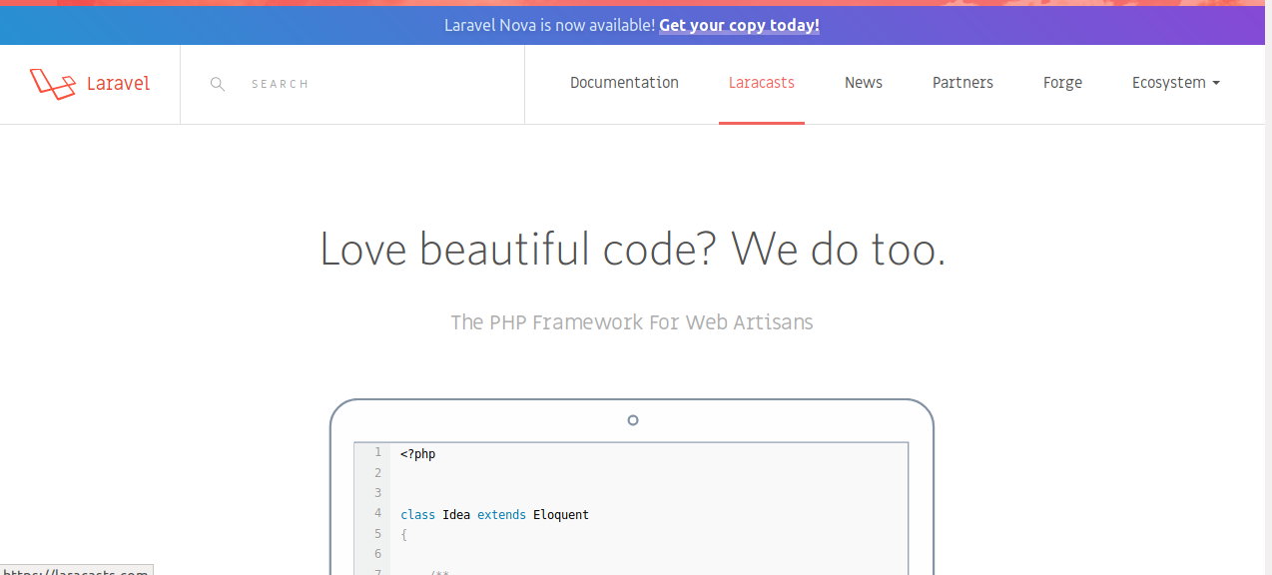

Slide 3
Laravel
Laravel is a free, open-source PHP web framework, created by Taylor Otwell and intended for the development of web applications following the model–view–controller (MVC) architectural pattern and based on Symfony. Some of the features of Laravel are a modular packaging system with a dedicated dependency manager, different ways for accessing relational databases, utilities that aid in application deployment and maintenance, and its orientation toward syntactic sugar.

Slide 4
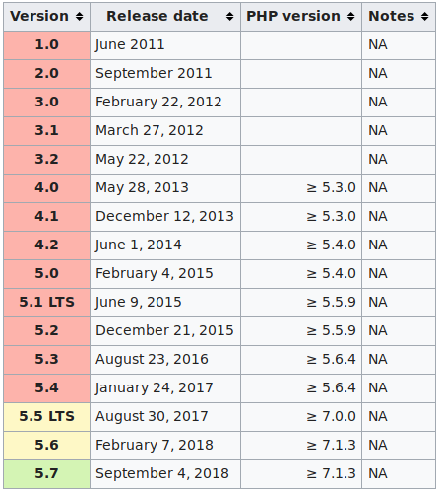

Slide 5
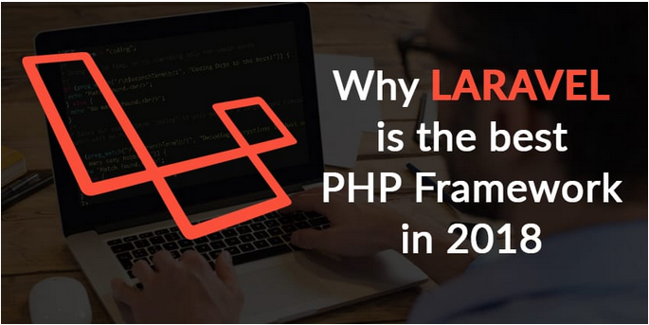
Why LARAVEL is the best

Slide 6
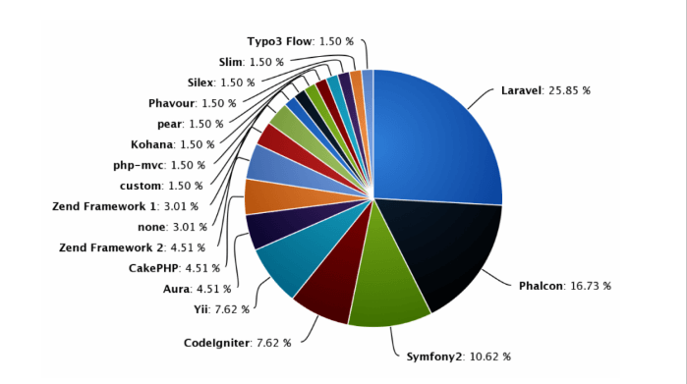

Slide 7
Find features of best php laravel
Template Engine
Artisan
Eloquent ORM (object-relational mapping)
Libraries & Modular:
MVC Architecture Support
Migration system for databases
Unit-Testing
Security

Slide 8
Install Laravel
php -v
sudo apt install php7.2-cli
sudo apt install hhvm
Php -m
sudo apt-get install php-mbstring
sudo apt-get install php-xml
https://www.5balloons.info/how-to-install-laravel-5-5-with-xampp-on-linux/
chmod -R 775 foldername
php artisan serve --port 8001

Slide 9
App Folder
App:-Application Controller Folder
Controller:- app->Http->Controllers->new file create(hellocontroller.php)
Http:-Middleware
Kernel.php :-Middleware ko load karati hai
Php artisan make:model demo
Bootstrap :Dependency load autoload

Slide 10
laravel
Php artisan tinker
Blade: templete engine file

Slide 11
OPEN LARAVEL
php artisan serve --port 8001

Slide 12
Laravel start
View (itm.blade.php)
Controller (php artisan make: controller a)
Route :- Route ::get(‘itm’,’itmcontroller’);

Slide 13
Pass data to view(parameter send)
Way TO SEND VALUES TO VIEWS
1.using array function : array()
2.using compact function : compact()
3.using with : with( [] )
4.using withVariablename : withName()

Slide 14
using array function : array()
public function array()
{
$users = ["vikas","mohit","rahul"];
$name ="PNINFOSYS"
return view('include.array', array("users"=>$users , "name=>$name"));
}

Slide 15
channel Name: {{{$name}}<br/><br/>
@foreach($users as $user)
{{ $user}}<br/>
@endforeach
Foreach($users as $user)
echo $user
print_r

Slide 16
using compact function : compact()
return view('include.array', compact("users","name"));
return view('include.array')->with(["users"=>$users, "name"=>$name]);
return view('include.array')->withUsers($users)->withname($name);

Slide 17
Master layout file (fixed layout)
@yield :- <title>@yield(“title”)</title>
@section :- @section(“body”)
@show
@yield :jaha hamko values ko rendar karna ho.
@section : jaha hamko html ko rendar karna ho.

Slide 18
Master layout
@extends("layouts.master")
@section("title", "team is good");
@section("body")
Product
<p>Team my</p>
@endsection

Slide 19
Adding css/js files to layout files
Css link:-public->css->new file(master.css)
<link href=”public/css/master.css”>
Js link :- public->js->newfile (master.js)
<script type="text/javascript" src="public/js/master.js"></script>
href="{{ URL::to('/') }}/public/css/master.css"
<li><a href="{{ url('/download')}}">Download</a></li>

Slide 20
Convert HTML single page web site
Move asset files to /public folder
Make a New Controller
Make all required methods within controller
Make a fixed layout for site
Make view files for all methods to be redirection by extending layout
Configure routes

Slide 21
Conditional statements in Laravel
@if
@else
@elseif
@isset
@empty
@unless

Slide 22
@if and @else
{{ strlen($name) }}
@if(strlen($name) > 0)
String has lenght>0
@else
string has lenght =0
@endif

Slide 23
@elseif
@if(strlen($name) < 5)
String has lenght>0
@elseif(strlen($name)> 5 && strlen($name) < 10)
strlen length within 5 to 10
@elseif(strlen($name) >10)
string has length>10
@else
string has lenght =0
@endif

Slide 24
Isset function
@isset($name)
variable is set {{$name}}
@endisset
Variable is not found

Slide 25
@empty
@isset($name)
@empty($name)
Value is empty
@endempty
{{$name}}
@endisset

Slide 26
Conditional Statements
Loops:- @for , @foreach , @forelse, @while
Loop Variables:-
($loop->index, $loop->iteration, $loop->remaining, $loop->count, $loop->first, $loop->last)

Slide 27
@for
@for($i=0; $i<=7; $i++)
{{$i}}
<br/>
@endfor

Slide 28
@foreach
@foreach($names as $name)
{{$name}}<br/>
@endforeach-->

Slide 29
@forelse
@forelse($names as $name)
{{$name}}<br/>
@empty
No users found in list
@endforelse

Slide 30
@while
<?php $i=0 ?>
@while($i<=11)
{{$i++}}
@endwhile

Slide 31
Loop Variables
foreach($names as $name)
{{ $loop->index}}.{{$name}}<br/>
@endforeach-->
($loop->index, $loop->iteration, $loop->remaining, $loop->count, $loop->first, $loop->last)

Slide 32
$loop->first, $loop->last
@foreach ($names as $name)
@if($loop->first)
{{ $name }}<br/>
@endif
@if($loop->last)
{{ $name }} <br/>
@endif
@endforeach

Slide 33
@php
@php
$i=10;
switch($i){
case 1: echo "this is part 1"; break;
case 2: echo "this is part 2"; break;
case 3: echo "this is part 3"; break;
default: echo "this is default section";
}
@endphp

Slide 34
Conditional Statements
@php
@switch case
Comments{{-- this is pn --}}
Including subview in layout files
@include("html.templets.reviews")

Slide 35
Migration(create Table)
Php artisan
php artisan make:migration create_users_table –create=users
/opt/lampp/htdocs/myProject/storage$ sudo chmod -R 777 logs( error)
Php artisan migrate

Slide 36
Model Create with table
Php artisan make:model post -m

Slide 37
Rolling Back Migrations(drop)
php artisan migrate:rollback
php artisan migrate:rollback –step=4
php artisan migrate:reset

Slide 38
Update Table Schema
php artisan make:migration update_mobile_table --table=mobile
$table->string('address',300);
$table->string('brand',100);
$table->integer('mobile_id');
php artisan migrate:reset
Table Name:- mobile

Slide 39
PHP ARTISAN TINKER
1.Create table (Migration)
2. Migrate created Migration file
3. Go to “php artisan tinker”
4. Crud operations (create, Read, update, delete)
--- CREATE
1. Single Row Insertion
2. Multi Row Insertion

Slide 40
PHP ARTISAN TINKER
1.Php artisan make:migration create_students_table __create=students
2. Php artisan migrate
3.Php artisan tinker (Laravel\Tinker\TinkerServiceProvider::class,)
config->app.php (Add link)
4. Echo “hello world”

Slide 41
INSERT DATA
DB::table('users')->insert( ['email' => 'john@example.com', ‘roll' => 122] );
DB::table('students')->insert(
['name' => 'vikas', 'email' => 'jain@gmail.com', 'location' => 'bhind', 'cre
created_at' => New DateTime]
);

Slide 42
Default data (Multiple data)
DB::table('students')->insert(
... ['email' =>'raj@gmail.com']
... );
DB::table('users')->insert([ ['email' => 'taylor@example.com', 'votes' => 0], ['email' => 'dayle@example.com', 'votes' => 0] ]);

Slide 43
View Data(Read)
DB::table('students')->get()
DB::table('students')->where('email', 'jain@gmail.com')->get()
DB::table('students')->where('location','bhind')->first()
DB::table('students')->where( ['email'=>'jain@gmail.com'] )->first()
DB::table('students')->pluck('name');
DB::table('students')->select('name','email')->get()

Slide 44
Aggregate Function
DB::table('students')->count()
DB::table('students')->max('id')
DB::table('students')->min('id')
DB::table('students')->avg('id')

Slide 45
Update Query
DB::table('students')->where('id',1)->update( ['name' =>'sneha'])
DB::table('students')->where('id',1)->update( ['name' =>'snehavikas','email'
=>'jainvki@gmail.com'])

Slide 46
Delete Query
DB::table('students')->where('id',2)->delete()

Slide 47
Query Builder (use DB;)
class dbcontroller extends Controller
{
public function queryrun()
{
$data = DB::table('students')->insert( [
['name' =>'viki', 'email' => 'viki@gmail.com', 'location' => 'bhind'],
['name' =>'mohit', 'email' => 'mohit@gmail.com', 'location' => 'etawah'],
['name' =>'anit', 'email' => 'anit@gmail.com', 'location' => 'gorami']
]
);
echo $data;
(Queryrun.blade.php)

Slide 48
Eloquent and Model
1.Insert data use Model (First method data insert)
2.php artisan make:model Product
public function insertorm(){
$product = new Product();
$product->name ="demo product";
$product->quantity =10;
$product->description ="this is good ";
$product->save();
}

Slide 49
Second Method Insert (Model)
$product = new Product(
['name' => 'demo8', 'quantity' => 40, 'description' => 'Hello data'
] );
$product->save();*/
protected $fillable = ['name', 'quantity','description']; //to be inserted (model)

Slide 50
Third Method Insert
$product = Product::create(
['name' => 'demo11', 'quantity' =>90, 'description' => 'good'
]);
protected $guarded = []; //to not inserted (model)
}

Slide 51

SELECT UPDATE DELETE

Slide 52
Request Validation
{{csrf_field()}}
value="{{old('name')}}"
public function submitmyform(Request $request){
$this->validate($request, [
'name' => 'required',
'email' => 'required |max :20|min:8|email|unique: students',

Slide 53
Validation From Request
php artisan make:request myform

Slide 54
CURD Resource Controller
php artisan make:controller StudentContoller –resource
Route::resource(‘student',‘StudentContoller');
Php artisan route:list
Php artisan make:model Student -m

Slide 55
Project SMS cache clear
Project Students Management System
php artisan optimize
php artisan cache:clear
php artisan route:cache
php artisan view:clear
php artisan config:cache

Slide 56
Login From Auth use
Php artisan make:auth
Problem migrate auth
Solve:-app/AppServiceProvider/
use Illuminate\Support\Facades\Schema;
public function boot()
{
Schema::defaultStringLength(191);
}

Slide 57
Accessors and Mutators

Slide 58
File Upload
php artisan storage:link

Slide 59
Database seeding

